Slide 1
Progress
TPR팀
김광용, 백승환, 조소민, 주민규

Slide 2

목차
Model 학습 그래프
Model 성능
ResNet50 성능

Slide 3
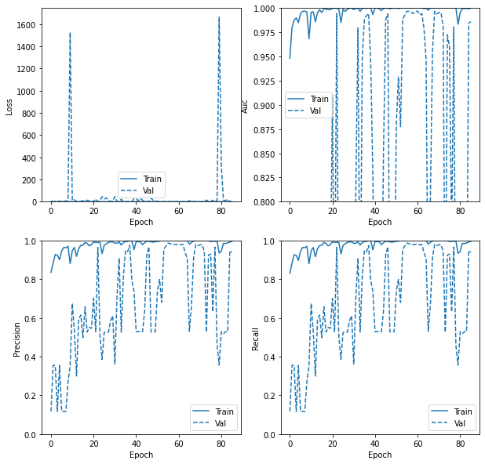
Model 학습 그래프
Epoch 별 Loss, AUC, Precision, Recall 그래프

Slide 4
Model 성능
Model | Accuracy | F1-score | Precision | Recall | AUC
Test | 0.9897 | 0.9845 | 0.9845 | 0.9845 | 0.9969
Validation | 0.9908 | 0.9862 | 0.9862 | 0.9862 | 0.9966

Slide 5
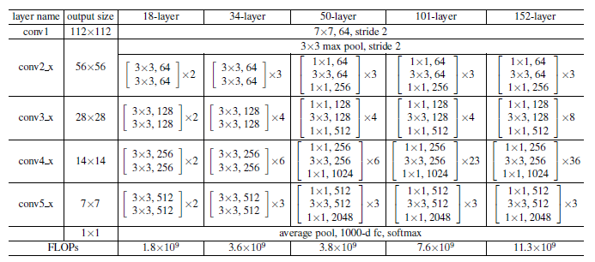
ResNet

Slide 6
ResNet50 성능
ResNet50 | Accuracy | F1-score | Precision | Recall | AUC
Test | 0.9856 | 0.9783 | 0.9783 | 0.9783 | 0.9946
Validation | 0.9839 | 0.9759 | 0.9759 | 0.9759 | 0.9966

